Slide 1
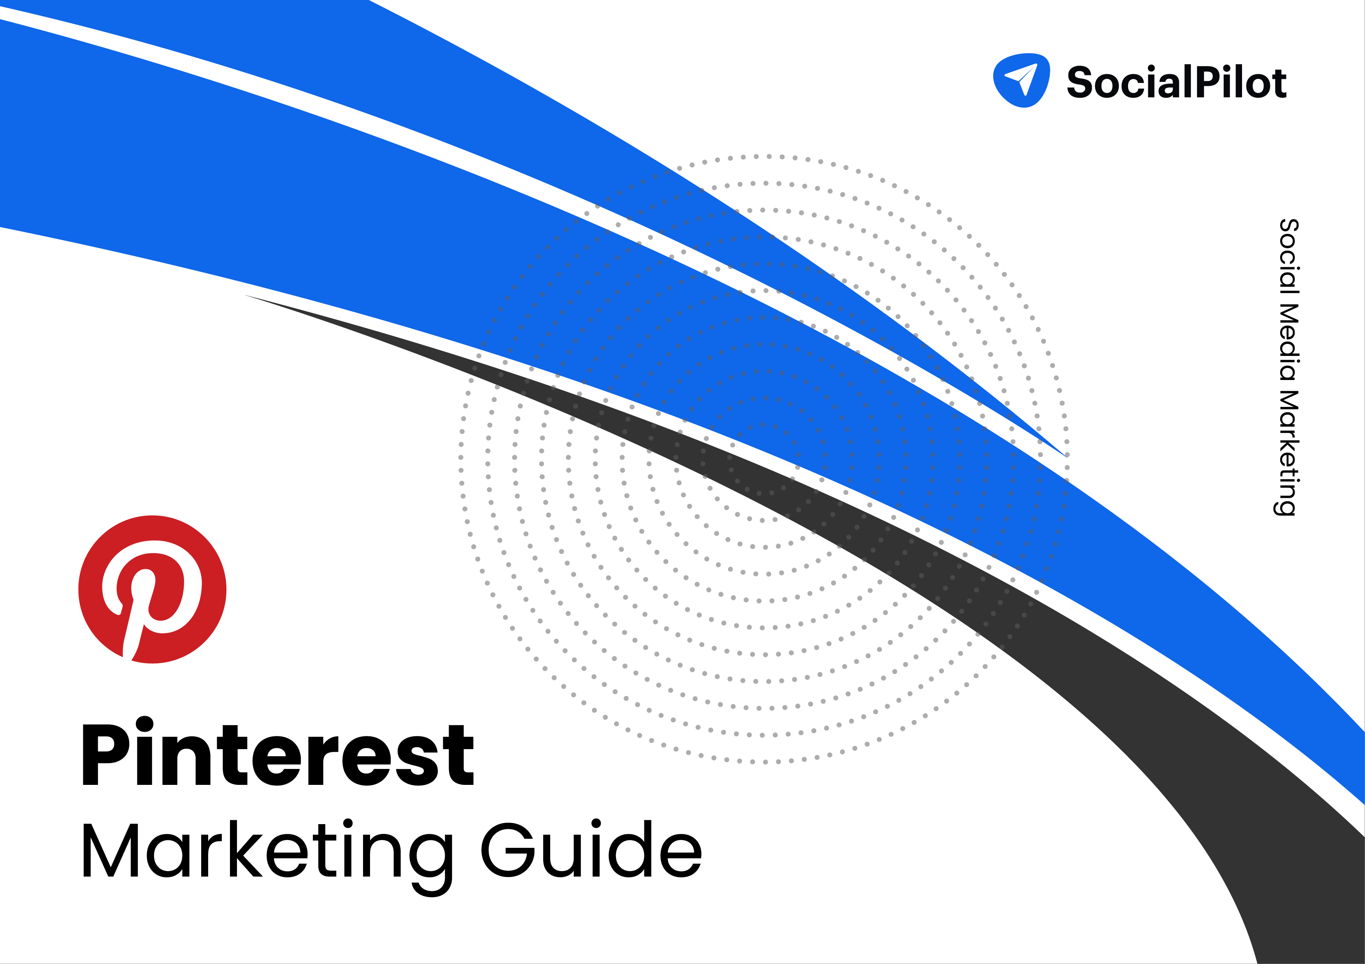

Slide 2
TABLE OF CONTENTS
Why Pinterest?
Understanding Pinterest
Creating your Pinterest account
Setting up your Pinterest account
How to increase traffic on Pinterest and drive more engagement
Understanding Pinterest Analytics
Some best practices for your Pinterest marketing strategy
02
03
07
09
11
19
24
01

Slide 3
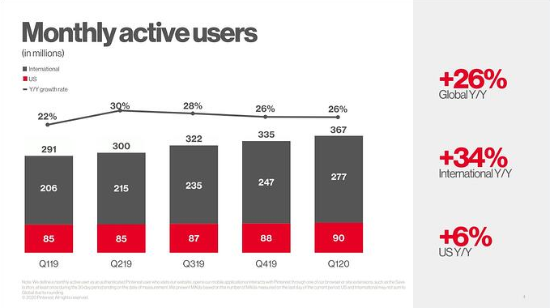
WHY PINTEREST?
The first thought that pops in anyone’s head on hearing social media marketing would be Facebook, Twitter, Instagram, and even LinkedIn.
And rightly so. These platforms command huge influence owing to billions of users spread out worldwide. So naturally, marketers and brands would focus most of their energy and attention on these platforms.
But, if you are prepared to venture out to the less explored lands and be creative then you can’t go wrong with Pinterest.
In fact, Pinterest is the dark horse of the social media marketing world. It’s relatively lesser known and is often neglected or barely paid any attention to.
However, Pinterest is not unpopular with the audience. 87% of people on Pinterest have bought a product because of Pinterest, while 93% use Pinterest to plan a future purchase.
In fact, it's becoming even more popular with users year after year. In 2020, global monthly active users grew 37% year over year to 442 million.
According to proprietary user data from Pinterest, It has grown stably with a 9.55% quarter-on-quarter growth rate, outpacing the same at Snapchat (5%), Twitter (9.21%), LinkedIn (2.22%) and Facebook (4.20%). (Source - Socialmediatoday)
If you’re still not convinced why Pinterest is such a big deal for your business, check out these surprising Pinterest trends from the last year.
So, if you’re wondering how to get started with marketing on Pinterest you’ve come to the right place.
02

Slide 4
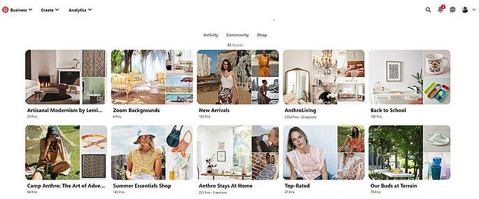
UNDERSTANDING PINTEREST
Who doesn’t remember the countless hours spent browsing Pinterest looking at decor, art, and clothing among many other things .
If you’ve been using Pinterest you’d know that Pinterest is a very visual platform with users sharing beautiful visual content. Pinterest also helps users explore and curate inspiring ideas.
On Pinterest users add or ‘Pin’ their content to their boards.
Think of a Pinterest Board as a folder containing all your content with a common theme. You can collect and organize ideas and inspiration in these boards and they’ll help other users easily discover and find new content related to their searches or interests.
Each Pinterest board has its unique name so you could group similar pins under a certain idea or theme. It also helps your followers to easily browse through your content.
Pinterest is all about finding and pinning content both from the platform itself and from the broader web. You can then aim to generate engagement using your boards and pins by following other boards, commenting and re-pinning other pins and sharing your website and blog in your pins.
Now, let’s get into the details and understand some basic terms used on Pinterest.
Pinner
The person who uses Pinterest to save or post pins, boards on the platform, or an image from the internet is called a pinner. Just as the “grammers” for Instagram, “members” for LinkedIn, “tweeps” for Twitter colloquially, “Pinners” is for Pinterest.
Pins
Pins are the posts of Pinterest. They can be an image, infographic, or a video containing a destination or a source hyperlink. You can also add a brief description and a title in your
03

Slide 5
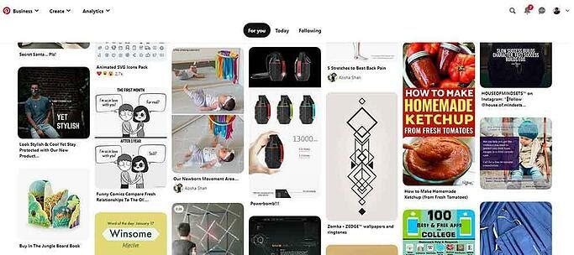
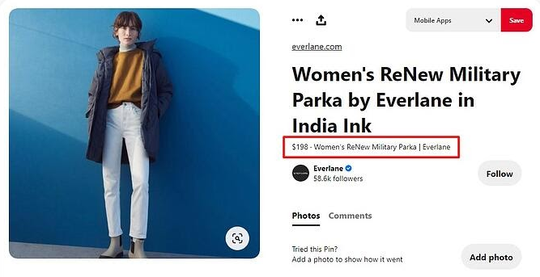
Pins to make them more informative and click-worthy.
On the Pinterest Home feed, you will find different types of Pins arranged according to the interest you have chosen and connected with on Pinterest before. You can also save the pins from other sources on your Pinterest boards.
(CPC) basis. Pinterest places these pins where people are most likely to see them. You also get targeting options based on location, gender, device, and language.
2. Rich Pins
Rich pins are normal pins but with more information such as install buttons, price, and recipe ingredients, etc. One of the best things about Rich pins is that they keep showing changes made on your website regarding your pin content since they reflect metadata from marked-up pages on your website.
There are 4 types of Rich pins:
Product Pins shows real-time pricing, availability, and product information on your pin.
Pins are the way pinners experience and find new content on the platform, As Pinterest stated: Pins are bookmarks that people use to save ideas they love on Pinterest.
Pinterest also has the following types of pins equipped with features needed to showcase your brand or product better:
1. Promoted Pins
Promoted pins function in the same way as organic pins, with the exception that they are paid ads that run on a cost per click
04

Slide 6
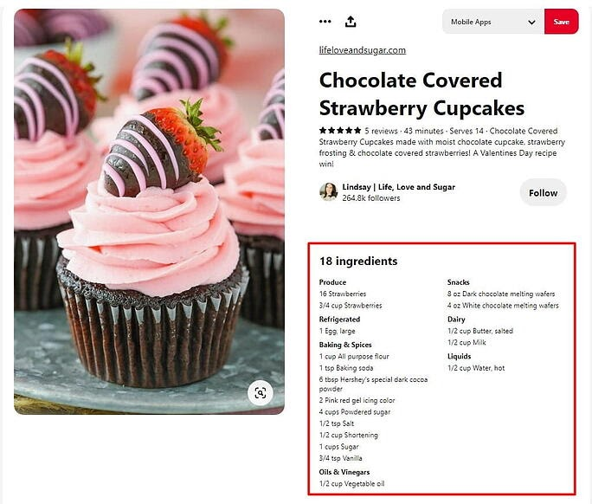
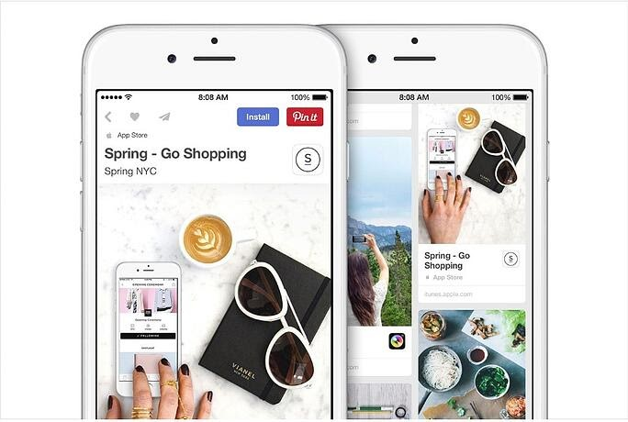
Recipe Pins include recipe ingredients, ratings, cooking times, and serving sizes.
Article Rich Pins shows headline or title, the description, and the author of your article or blog post.
3. Shop the Look Pins
Pinterest has jumped onto the native marketplace bandwagon with shop the look pins. Though limited to some countries, these pins let users find and buy products within the fashion and home décor Pins. Pinterest is also planning to roll out Shop the pins ads in the upcoming months.
Boards
There are different type of Boards on Pinterest:
Group boards: They are similar to the boards, with the exception that they can be used by multiple pinners to save Pins.
Secret Boards: As the name goes, Secret boards are only accessible to its creator and the invited Pinners. You can make any board a secret board, just by turning the toggle button off in Board edit settings. Marketers generally use these for planning or preview purposes, before making things public.
App Pins (iOS only) shows an install button.
05

Slide 7
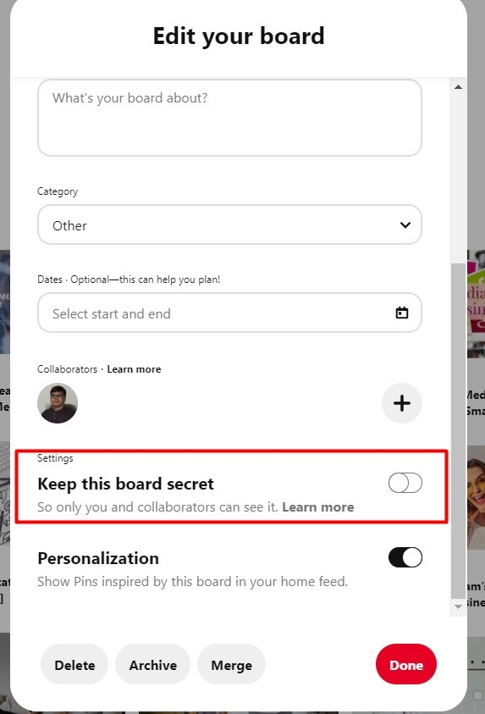
Protected boards: Protected boards are constituted of promoted pins which only you can see at the end of your profile whereas others can only see them surfacing in their search results and home feed.
Re-pin
Re-pin is an action like “share” is on other platforms. It happens when a user pins someone else’s content on their boards. It is a great way to keep your boards updated for your followers even while you are not creating original content.
Save button
It is a Pinterest plugin button for Chrome, Firefox, or Microsoft Edge that can be installed on your website. Using it Pinners can easily save content or products from your websites to their boards.
06

Slide 8
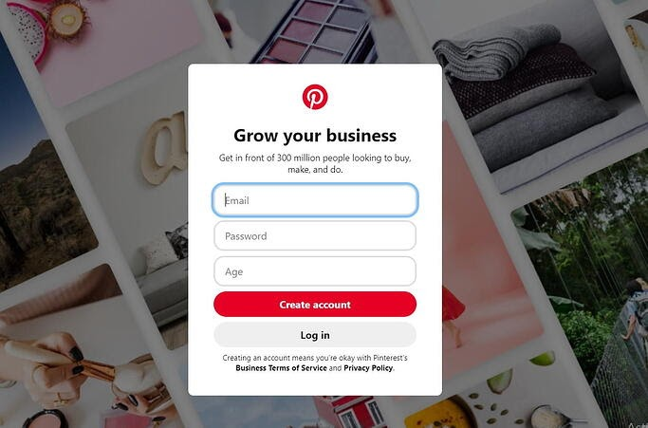
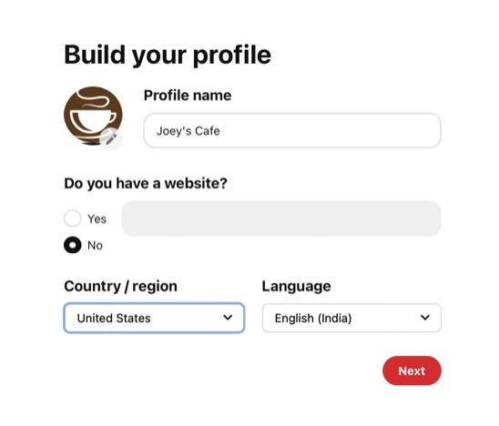
CREATING YOUR PINTEREST ACCOUNT
There are two types of Pinterest accounts - personal and business accounts.
A Pinterest business account also gives you access to Pinterest Analytics and also opens up other capabilities such as running ads. So if you are looking to set up your Pinterest Marketing strategy then a Pinterest business account is the best way to go.
You can set up a Pinterest Business account in two ways:
Create a new business account from scratch, or
Change your personal Pinterest account to a business profile.
You can directly set-up your Pinterest business account from here.
To convert your Pinterest personal profile into a business account click on the arrow given on the top right side of your desktop screen. You’ll see a “Convert to business” option in the drop down menu.
07

Slide 9
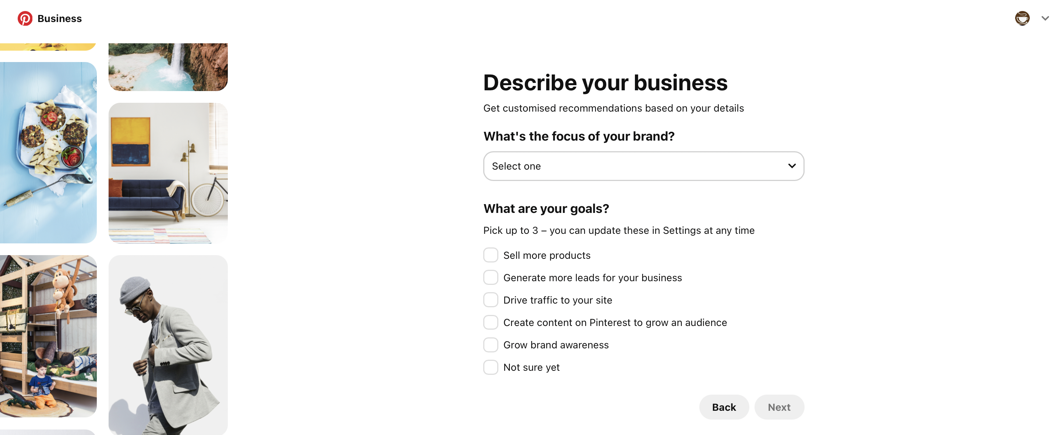
Click on Convert to business on the next screen and you’ll be then asked to fill in some information about your business.
You can choose to put a profile picture of your brand here or later while editing your profile with more options in settings.
08

Slide 10
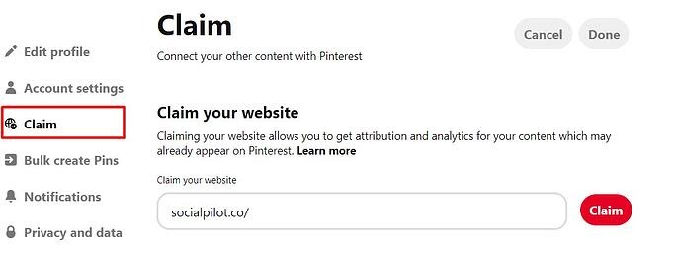
SETTING UP YOUR PINTEREST ACCOUNT
Once you have created your Pinterest business account, you can start editing it to create maximum impact on your audience.
Click on the drop down icon on the top right hand side of the page and you’ll see the Settings options. Click on that and you’ll be taken to the edit profile page.
You can upload or change your brand profile picture here. One important tip here is to make sure you use the same profile picture you used on other social media platforms to maintain brand consistency and awareness.
Claim your website
You might be wondering what does claiming your website mean? Well, here’s everything you need to know about it.
Claiming your website helps you get credit for all your content on Pinterest. When you claim your website, your profile picture and name will appear next to any Pins that come from your website or social accounts.
By claiming your website, you’ll also get in-depth analytics about your content’s performance on the platform.
Claimed accounts also have the benefit of getting more visibility and followers as it tells users where they can see more content from you. Here’s a step-by-step guide from Pinterest on how to claim your site.
Connect your Youtube, Instagram, and Etsy account
Similar to claiming your website, you can also claim content from your Youtube. Instagram and Etsy account on Pinterest.
isn't that wonderful?
Pins from all these sites will be attributed to your account and also you will get analytics for all pins saved from your claimed accounts.
09

Slide 11
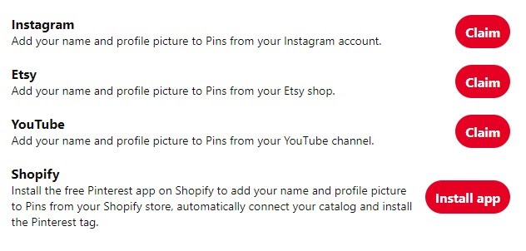
Want more?
Another exciting feature here is that you can install your Pinterest app in your Shopify account to add your name and profile picture to Pins from your Shopify store.
10

Slide 12
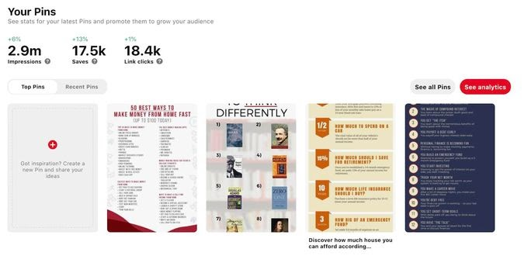
HOW TO INCREASE TRAFFIC ON PINTEREST AND DRIVE
MORE ENGAGEMENT
Engagement is the name of the game on Pinterest. If you’re continuously generating engagement and traffic on your Pinterest profile, it’ll quickly translate into business and revenue growth.
And one of the most sure-fire ways to do that is Fresh Pins. Fresh pins can drive crazy amounts of traffic to your website or blog.
Pinterest attracts users who come there to discover new ideas and content, so it's easy to see why fresh pins get more visibility and traffic on Pinterest.
So, the answer to getting more traffic is pretty clear right now - more fresh pins.
But more is not necessarily better in this case. Simple and plain fresh pins with just image and a text overlay doesn’t do much to excite users and generate engagement.
So, the focus here should be on user-first. Consistently, generate
content that users like and want to interact with. After all, no one likes to see the same old 5-6 pins again and again with slight changes in design or text.
In content marketing, the trend has been to create content in multiple formats. Some people want to read blog posts, while others want to watch videos or listen to podcasts.
The same principle can be applied to Pinterest, where different users prefer different types of content.
11

Slide 13
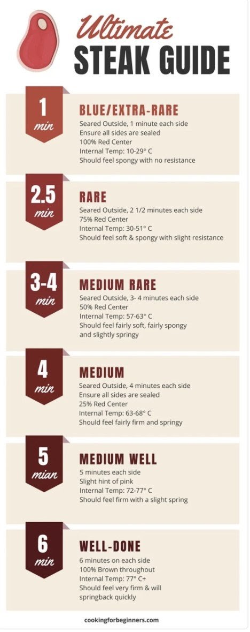
These types can include infographics, lists, charts, tables, and graphs (just to name a few). And as a Pinterest creator, it’s essential to give users what they want.
So, to get your Pinterest marketing strategy rolling, here are some different type of pin ideas that go beyond the ordinary and capture the user’s attention.
Pin type #1: Simple infographic pins
It’s not surprising that infographics have consistently performed well on Pinterest. When someone doesn’t feel like diving into a long post or is only in the research phase, they can easily save the pin for later consumption.
But what may come as a surprise is the fact that very simple information graphics can work just as well as their more elaborate counterparts.
Also, you don’t need to hire a graphic design artist every time you want to produce one.
Canva has dozens of infographic templates that you can customize with 10 or 15 minutes of work. An example of a simple infographic template would be this guide on cooking steak:
12

Slide 14

In fact, I quickly modified this template to create an infographic on financial rules of thumb:
This URL now has over 128,000 saves.
I categorize infographics as graphics that display an entire idea or post in one image. This information gets a lot of saves and therefore tells Pinterest that the content is valuable.
And while the click-through rate can be lower for infographics than for other types of Pins, they tend to reach many people. That means they’ll still bring a significant number of visitors to your site.
Interesting Read: 5 Types of Interactive Content That Will Help You Stand Out
Pin type #2: List pins
Some of my all-time top Pins — in terms of both saves and link clicks — are list Pins.
Fortunately, list Pins couldn’t be easier to create as they contain a headline plus a list.
This method works great for any list post that you have on your blog. Just take the different list items on the post and embed them into an image.
For example, over time, I’ve created multiple list Pins for a post I have on different online jobs, which has resulted in over 60,000 total saves to the URL.
13

Slide 15
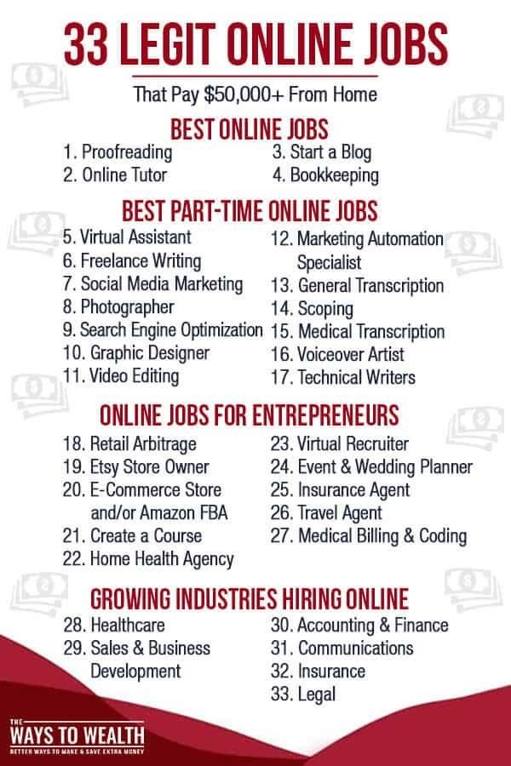
While this method works great for list-specific posts, often, you can create list Pins based on one section of a post that’s not a dedicated list post.
Sticking with the steak example: along with the recipe, you might have a section in the post on tips for making the perfect steak. Even short, that list of tips can make for another type of pin that users like to save.
Pin type #3: Charts, tables, and graph pins
Charts, tables, and graphs are another way to present information that’s helpful to Pinterest users.
What you’re looking for are ideas that overlap with your blog post’s intent.
For example, a post on cooking steak could have a chart about the different temperatures for cooking steak and the estimated cooking time needed for each temperature.
This gives you another angle and more keywords to potentially rank for to attract readers to your website.
Closely related are graphs and tables, which offer another way to display helpful information easily.
I’ve found that comparison tables do quite well.
A good tip here is to go to the Pinterest search bar and enter your main keyword plus the term “vs.” This will show you different comparisons that users are actively searching on Pinterest.
14

Slide 16
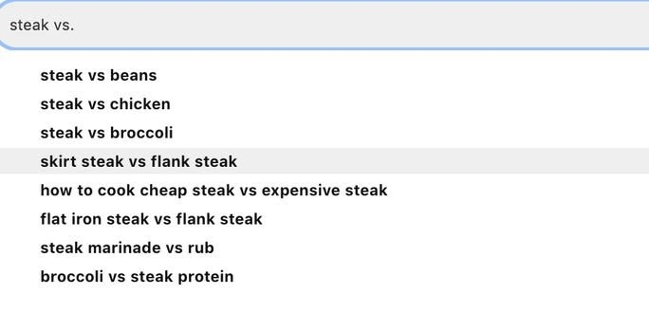
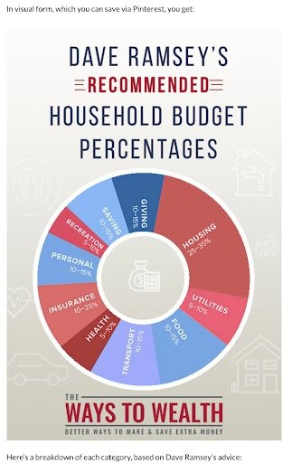
Since this is information users are actively searching for, it’s not a bad idea to insert sections into your article about these specific topics.
For example, in a “how to grill steak” article, you may want to have a section about the difference between grilling a skirt steak and a flank steak.
The secondary benefit here is that you can embed your designed comparison charts inside your content, which creates another powerful and helpful visual element to your on-page content (and tends to get a lot of saves).
One example is this chart of recommended budgeting percentages that I embedded in a blog post.
This URL alone has now been saved over 90,000 times, with the majority coming from the above chart embedded in the content.
Interesting Read: How Small Businesses Can Make the Best of New 'Shop the Look' Pins
15

Slide 17
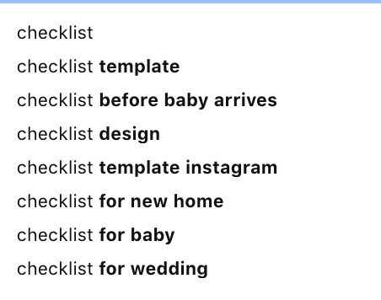
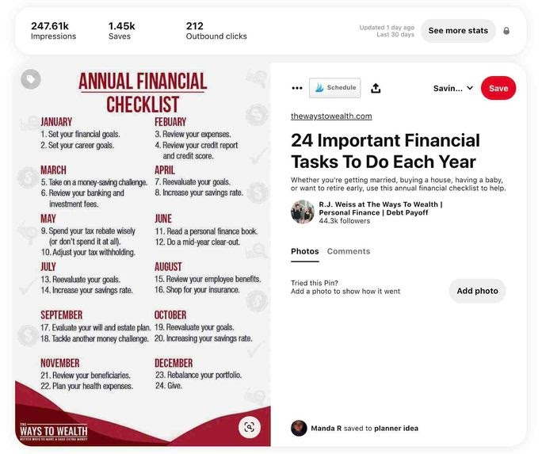
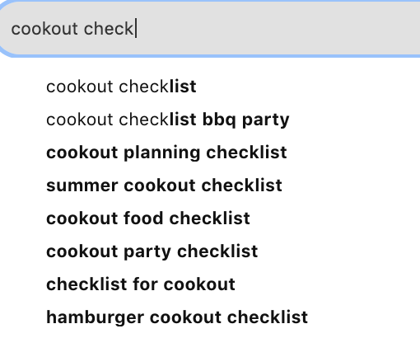
Pin type #4: Checklist pins
Another simple pin concept that users love seeing is checklists. Search for “checklist” inside of Pinterest, and you’ll quickly discover that this idea is applicable in many different niches.
You don’t have to create a standalone blog post to support a specific checklist. Adding a section that includes a checklist — whether to a new post or existing content — can add a nice visual element to a post and give the reader something to save.
A personal example from my account, and one of my top-performing Pins of all time, is an annual financial checklist.
Try adding a keyword in front or ahead of the term to get more ideas for checklists you can create.
16

Slide 18
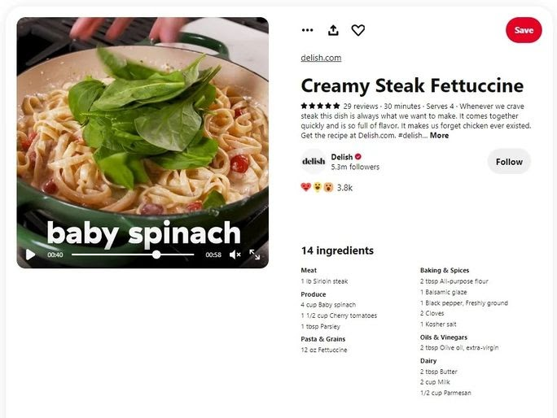
Pin type #5: Video pins
Video Pins are something I’ve just started to experiment with. But as a Pinterest user, I thoroughly enjoy them.
Video Pins tend to work best when you’re demonstrating something visual. As an example, for our cooking steak guide, we could create an entire video of the process.
Delish.com did precisely that in the pin below:
In turn, your one post can go after a wide range of keywords.
Summary
If you’re trying to reach more people on Pinterest, give these different types of Pins a try.
For example, if your goal is to create eight different fresh Pins per post, you might break that target down into four text overlay Pins, one infographic, two list Pins, and one comparison table.
Furthermore, using different pin types to expand the keywords your pin can rank for potentially. A good tip is to create Pins for the different subheaders within your content.
Using the steak example, your pin breakdown could be:
Text Overlay Pin #1: How to Grill a Steak
Text Overlay Pin #2: How to Grill the Perfect Steak on a Gas Grill
Text Overlay Pin #3: The Best Grilled Steak Marinade
Text Overlay Pin #4: How to Grill a Steak Medium Rare
Infographic Pin: Step-By-Step Guide to Grilling a Steak
Table #1: Steak Temperature Guide
Checklist: How to Prepare a Steak for the Grill
Video Pin #1: How to Make Diamond Marks on Grilled Steak
Now you just went from targeting one keyword (“How to Grill a Steak”) to multiple keywords that can bring visitors to your site. More so, you didn’t have to create a separate blog post to achieve this.
You could also take different angles that break down further steps of cooking a steak. For example, how to properly season asteak or create the perfect grill marks — both of which are something that users search for commonly.
17

Slide 19
But, creating fresh pins does take more work. And if you are a social media marketer managing Pinterest accounts of multiple clients, it can get pretty tiresome.
To better manage multiple Pinterest accounts and your sanity, you can use different Pinterest tools. For instance, SocialPilot, a Pinterest marketing tool, help you schedule pins on numerous board way ahead of time.
Pinterest marketing tools enable you to focus more on creating quality content as it takes care of publishing pins for your clients automatically.
18

Slide 20
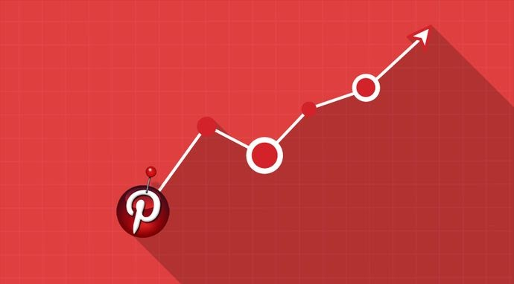
UNDERSTANDING PINTEREST ANALYTICS
Pinterest has attained great success in driving traffic and sales with the help of customer engagement.
There are no second-thoughts on your efforts that should be driving traffic to your site through Pinterest. After all, it is one of the best sources of referral traffic on the Internet.
However, the real question is how someone can find that their Pinterest marketing campaign is working in an adequate manner or not? You can answer this question only when you look at in-depth analytics of your profile.
It will also help you to know the efforts needed to optimize images on your site for this platform and the number of products you should add directly to the board.
Read: How To Use Pinterest To Increase Traffic To Your Blog?
19

Slide 21
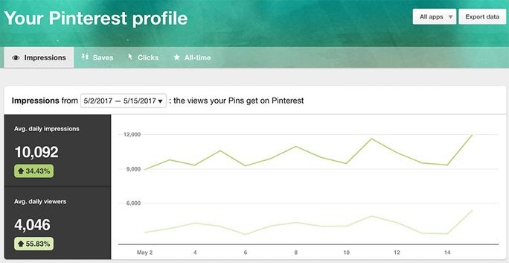
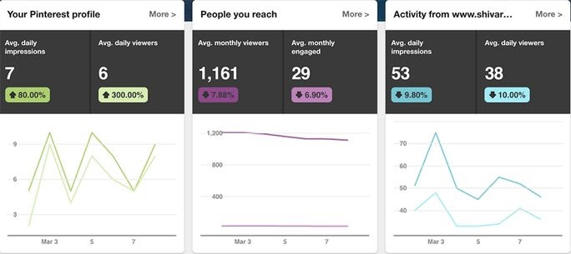
How to Get Access to Pinterest Analytics?
There are two ways you can access the Pinterest analytics: Using Pinterest's native analytics page; using the social media tracking tools like SocialPilot.
We are going to start with the Pinterest native analytics section.
As mentioned before in this guide, you’ll require a Pinterest business account for getting access to Pinterest Analytics.
After landing on your account homepage, you can use the analytics section by clicking on the main Analytics button located on the top left side of the screen. This will take you to the overview screen where you will find a complete description of how well your content is performing.
Here you will get complete information on average daily viewers, average daily impressions, average monthly engaged viewers and average monthly viewers that are the results of your achievements. It also enables you to check the overall metrics of your website (only if you link your website).
At the end of the overview page, find details of your "Top Pinterest Pin impressions” from the past 30 days. This area will also let you see the saves, likes, clicks and pin types.
You can also check complete details of your Pinterest profile activities by hovering over the Analytics option located at the top of the profile and then click the “Profile” on the drop-down menu. At last, you will land to the page looking like the screenshot given below:
On this page, you can switch between the tablets for checking your Pinterest Impressions, saves, clicks, and All-time (Your most shared pins).
20

Slide 22
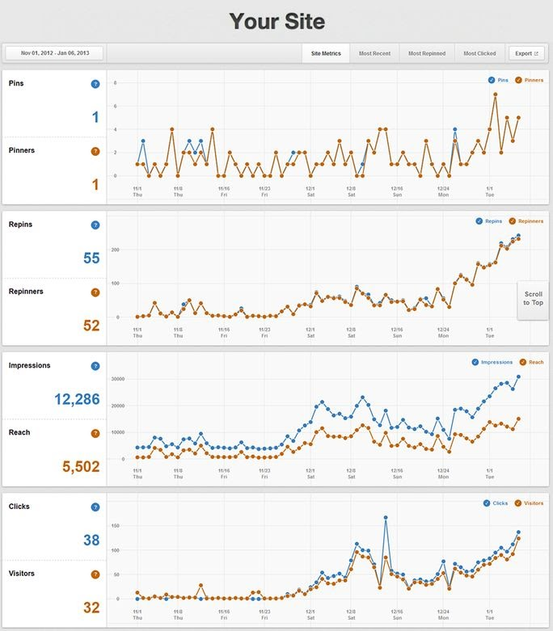
2. Know the exact meaning of your Pinterest Site Metrics
You will get access to Pinterest site metrics only if you verify your domain name.
Here's how it will look like:
The most important thing to note in "Site Metrics" is daily averages of pins that come from your site. The measurement of your business’s pins or repins that you upload directly are excluded in this data. The site metrics tell you about some more important things explained below in brief:
Pins & Pinners - Check who is pinning your content?
It is interesting to check out the number of people pinning from your website and on which day the active engagement reaches its peak. These measurements result in more accurate determination on what kind of content should be added to the website and on which day of the week, it should be posted.
Repins & Repinners - Users who repin your pins
Calculating the exact quantity of repins received by a single item of your site can assist in finding what type of content spreads the most. This will give you a good idea of what type of content you should create the most.
Impressions & Reach - Number of people watching your products
The impressions will let you know about the number of times your content shows in the Pinterest boards or news feed. It will let you see if your products don’t have a good description and are not being able to enter the search and frequency of your pins.
21

Slide 23
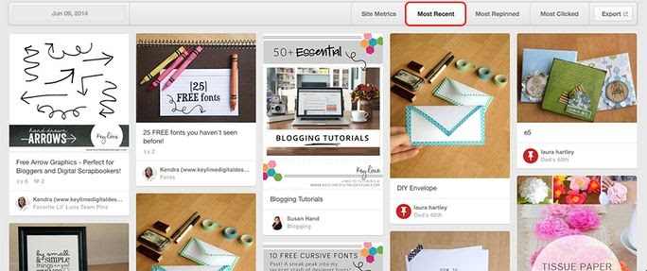
The importance of reach is more as compared to the impressions because it will give you information about the number of unique people watching your Pinterest Pins. Optimizing images on your site, adding right descriptions and a "Pin It" button can increase these Pin numbers. The quantity of traffic and transactions can be increased by having an increased number of unique views.
Clicks & Visitors - Check out who is highly engaged with your pins?
Clicks offer you the same information you will collect from your Google Analytics. The only difference is that, the clicks are derived only on the basis of the number of times a visitor clicks from a pin that arrives from your website.
3. Find your most popular content among the customers
The Most Repinned tab is the incredible feature of Pinterest social media analytics. It shows you the most admired items of the platform. Checking this data frequently will assist you to find what type of content you need to add more to your site and what type of pins you should upload to your boards.
The best way to utilize the Most Repinned tab is to have a look at a rise in repins, determine a date and set it in the calendar from the Most Repinned tab. This way you will be able to look at the most popular products.
4. How Analytics Help You Develop Your Buyer Persona?
According to Hubspot, "Buyer persona is a semi-fictional representation of your ideal customer based on market research and real data about your existing customers."
Pinterest analytics take you to the incredible journey of your potential customers.
How?
Click on "People You Reach" under Analytics Section and you will redirect to the given below screen:
22

Slide 24
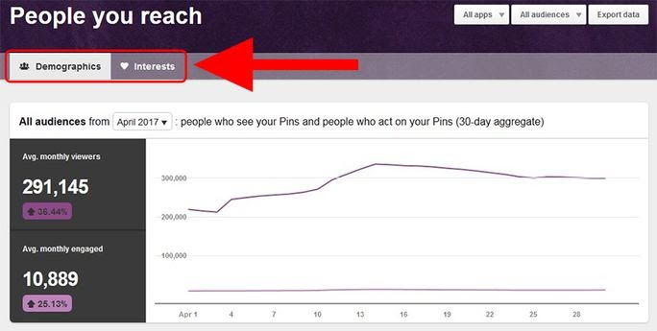
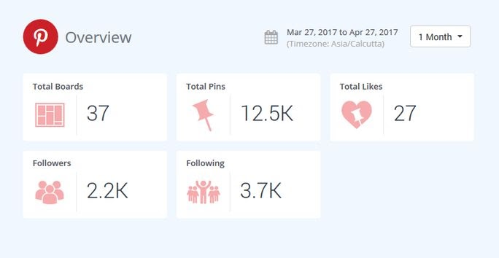
Scroll down on the same "Demographics" tab and you will get thorough details of your audience including their countries, cities, languages they speak, and gender. Switch to "Interests" tab and see the common interest or content your audience likes to share. All this data will help you develop your buyer personas.
You can use a social media scheduling tool like SocialPilot to efficiently manage your Pinterest marketing
Socialpilot not only helps you with Pinterest Scheduling, it also offers proper management and analytics features. Let's have some glimpses of how Socialpilot introduce you with all-inclusive Pinterest Analytics:
This is just an overview. Digging a little deeper will take you to a trip full of daily Pin analysis, engagement metrics, board analysis and performance analysis. You don't need to go anywhere else. Try it yourself.
23

Slide 25
SOME BEST PRACTICES TO MAKE THE MOST OUT OF YOUR
PINTEREST MARKETING STRATEGY
We all can agree that Pinterest is a great platform for marketers. With its high-intent audience and spectacular conversion metrics, Pinterest can be immensely useful for marketing your brand and growing your business. However, just pinning just about anything won’t work.. In addition to a fool-proof marketing strategy, you also need to keep some important aspects in mind that’ll help you achieve the kind of results you’re hoping for.
So without further ado, here are some tips and tricks to keep in mind while marketing your brand on Pinterest.
Have a complete profile
Complete your profile first thing if you haven’t done it already. Describe your business and include relevant keywords that help you reach your target audience. Have a profile picture, ideally the same one that you have usd across all other social media platforms. In addition, create some to get started and pin at least 9 pins on each board. This will give the board an active appearance and encourage the audience to explore your board.
Create Your First 5 Boards
If you haven't started pinning yet, now is the time! Start with creating your first 5 boards related to the topics that your audience would love. Add a few pins to each board. For instance, you can create 5 boards that your audience loves or create 5 boards for things your audience feel difficulty in finding.
Keep the focus on generating engagement
Maybe you don’t have a ton of Pinterest followers to start with. It's okay. Everybody starts with very few of them. The key to getting more audience is to engage with them! Direct messaging is an excellent option to go for it. You can reach out to people who have liked your posts, offer thanks to people who have repinned your images, set up group conversations to boost engagement on Pinterest.
24

Slide 26
Analyze your competition and follow them
To be the best at something, you need to see how others are doing it and learn from their wins and failures. Do some research and follow your competitors’ accounts. You can discover what they are actually doing on Pinterest and learn from their actions. Also, cross-promoting and encouraging each other on platforms provides you a wider audience!
Join a Community Board
In simpler terms, it's a collaborative board that is owned by a single person and then adds more creators to post on the board. You can request to join the board, or if you own a community board, you can as well invite people to collaborate.
Try researching and joining community boards within your business sector. This way you will reach a highly targeted audience that you wouldn’t otherwise have access to. Also, It is a great place to find relevant content to pin to your boards.
Include Rich Product Pin to Your Site
Rich Pins are Pins that include extra information right on the pin itself. They allow you to provide more information directly on a pin, making the pins more user-friendly. Rich pins drive more traffic to your website. All it takes is some basic knowledge of embedding, schema.org, and Open Graph.
Focus on Image Quality
Pinterest is all about visuals. Therefore, the more interesting the image you post, the more engagement you'll gain on Pinterest. Again, if you post high quality and attractive images on your blog posts, people are more likely to pin those as well.
Use Different Images to Link Back to Your Site
Suppose you have an old blog post that you would like to promote on Pinterest and the original article doesn’t have a pinnable image. You easily fix this by uploading a Pinterest friendly image. Simply, click on “+” on your Pinterest page and select “Upload a pin”.
Pin Regularly and Consistently
Pinning consistently helps maximize exposure and customer engagement with your brand. You can take help of social media scheduling tools to plan and schedule your pins in advance. Scheduling your pins on Pinterest will ensure regular posting.
Pinning consistently helps you #MaximizeExposure and #engagement.
Cross-Promote across platforms
If you have recently started using Pinterest, you should take advantage of other networks to grow your followers and
25

Slide 27
increase social traffic. You can tweet/post about your new pin/board on various social media platforms. This is a great way to announce your presence on Pinterest to your already existing audience on other platforms.
Don’t Just Pin Your Own Content
You should not pin your own content always. This rule of thumb is important because you want to keep your content fresh and dynamic to keep your readers reading. Rather than just pinning your own content, pin content related to your business, interesting images, quotes and mix in your products and articles. Create a different board that covers your targeted customer’s interests. This will also allow you to feature your best products beside them.
Don’t Forget to Add Pin it Button to Your Site
Undoubtedly, Pinterest makes it easy to add a social share button to your website. This makes it easier for users to share your images and you can also more easily control what images from your site are shared.
Don’t Use Too Many Hashtags
Most importantly, do not use too many hashtags in your pin description of your profile. Consequently, hashtags on Pinterest do not work the same as they do on Twitter or Instagram. So, use hashtags effectively in social media marketing, and most importantly, keep them relevant.
26

Slide 28
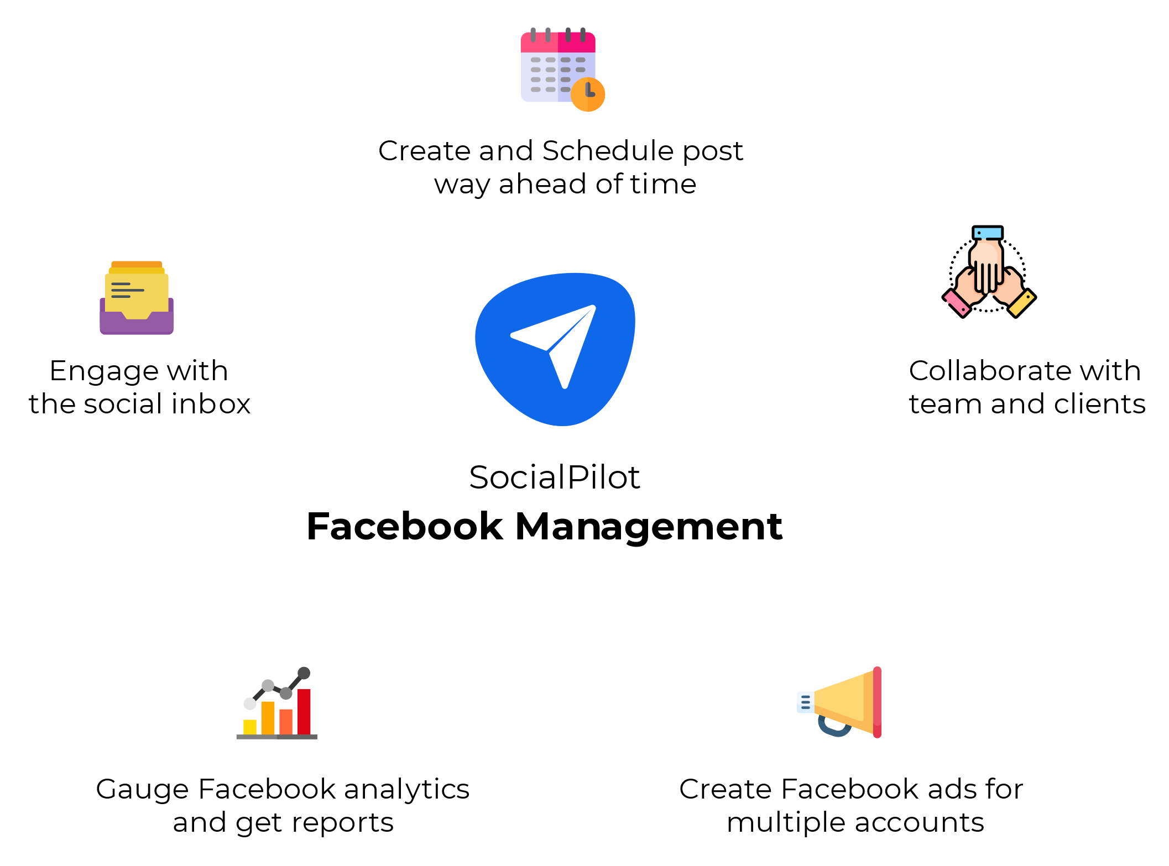
On a final note,
Your Pinterest Marketing strategy needs to be backed by flawless execution.
From coming up with highly engaging content ideas to finding the right content and understanding your audience's behavior, a lot of things need to be in place to create a strategy that gives you the results you want.
But, doing all that can quickly get taxing. It can be hard to make sure that every little thing is in place.
What you need is a social media management solution that lets you create and execute your brilliant social media strategies with ease.
SocialPilot is designed to help you manage all your social media accounts including Pinterest. It helps you find, schedule, and publish great content with in-depth analytics to generate better results from your social media strategy.
Give it a try today!
Try SocialPilot for free
27

